Slide 1
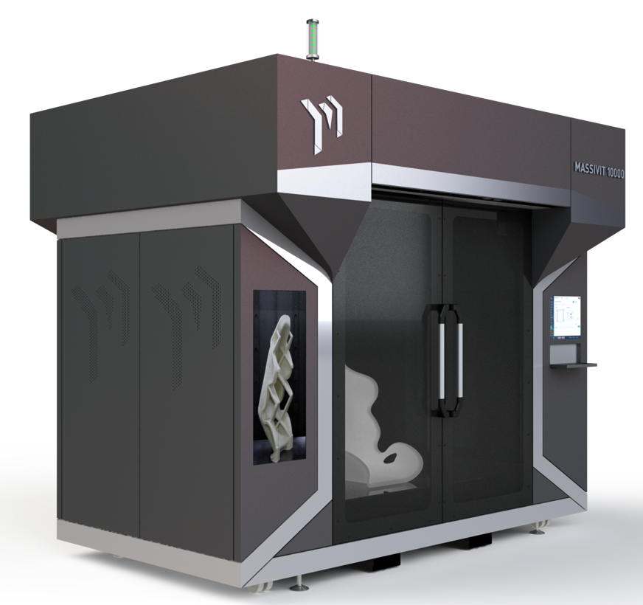
Massivit M10000
Lear Corporation Ltd –
RIM mold
Composite Lay-up tool Time and Material Estimate

Slide 2
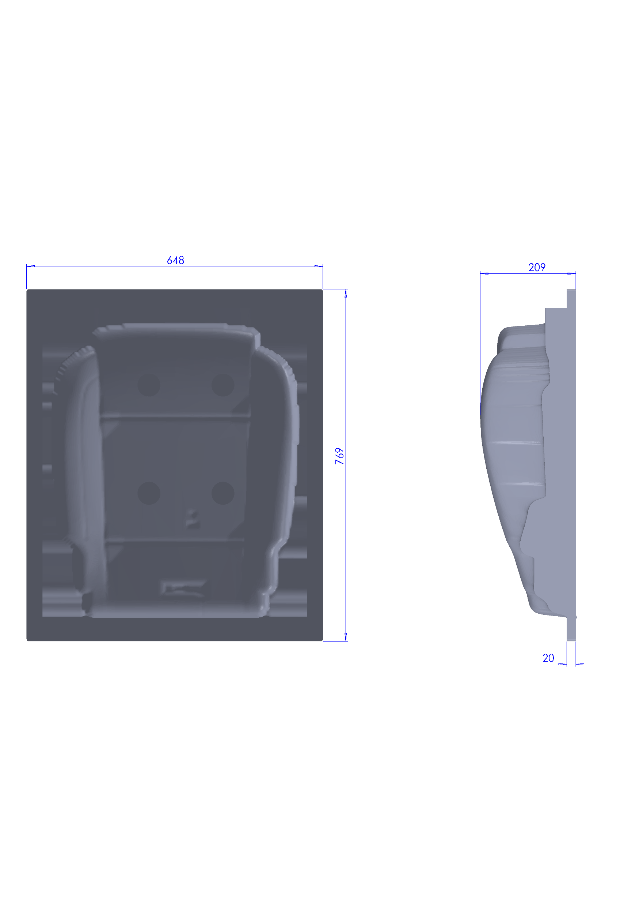
Size & Dimensions
part name : Cushion Foam Cavity

Slide 3
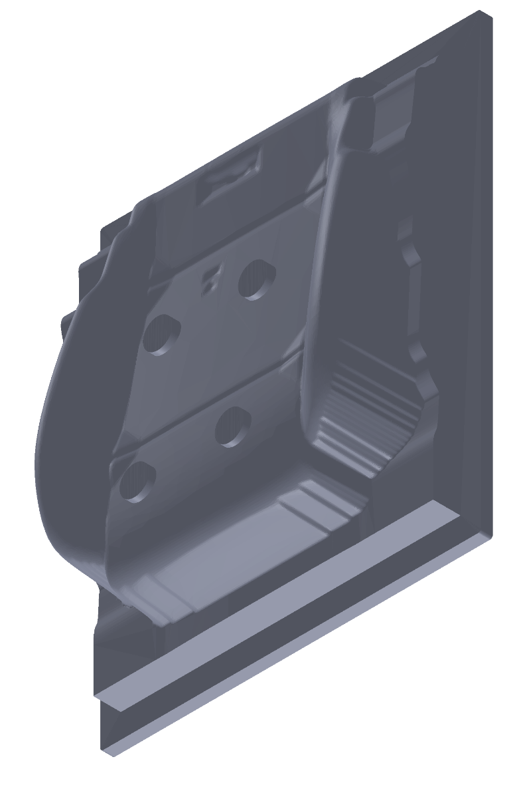
Details
Part: | Layer Thickness: | Casting cure material | Printing shell Material (Washable) | Total weight (Out of the printer) | Print time | Total weight (after shell removal)
Cushion Foam Cavity | 1 mm | 26 Kg | 10 Kg | 36 Kg | 29:10 hours | 26 Kg

Slide 4
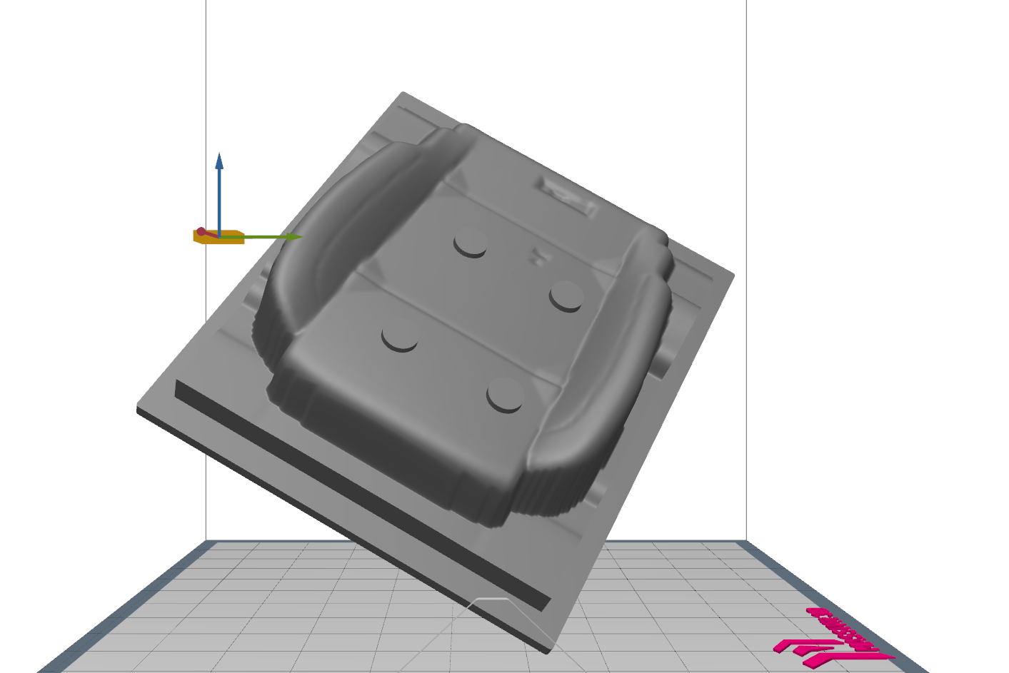
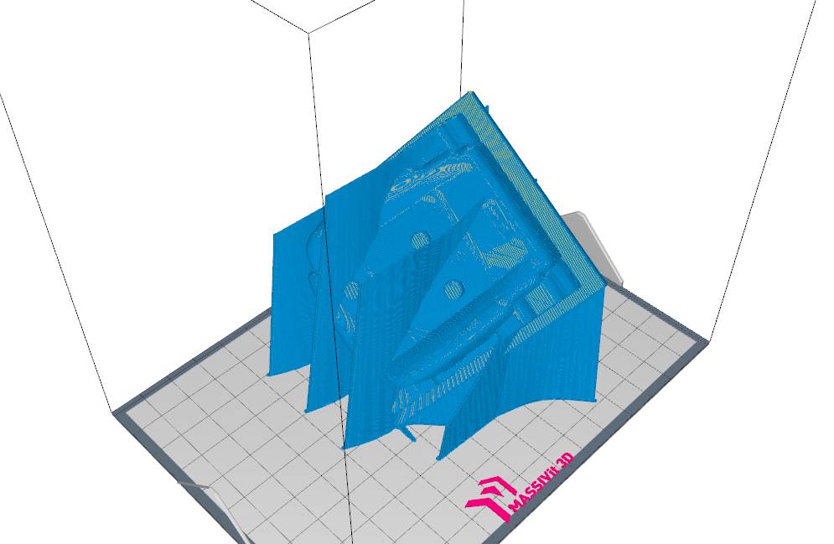
Printing orientation
STL file
Tool path

Slide 5
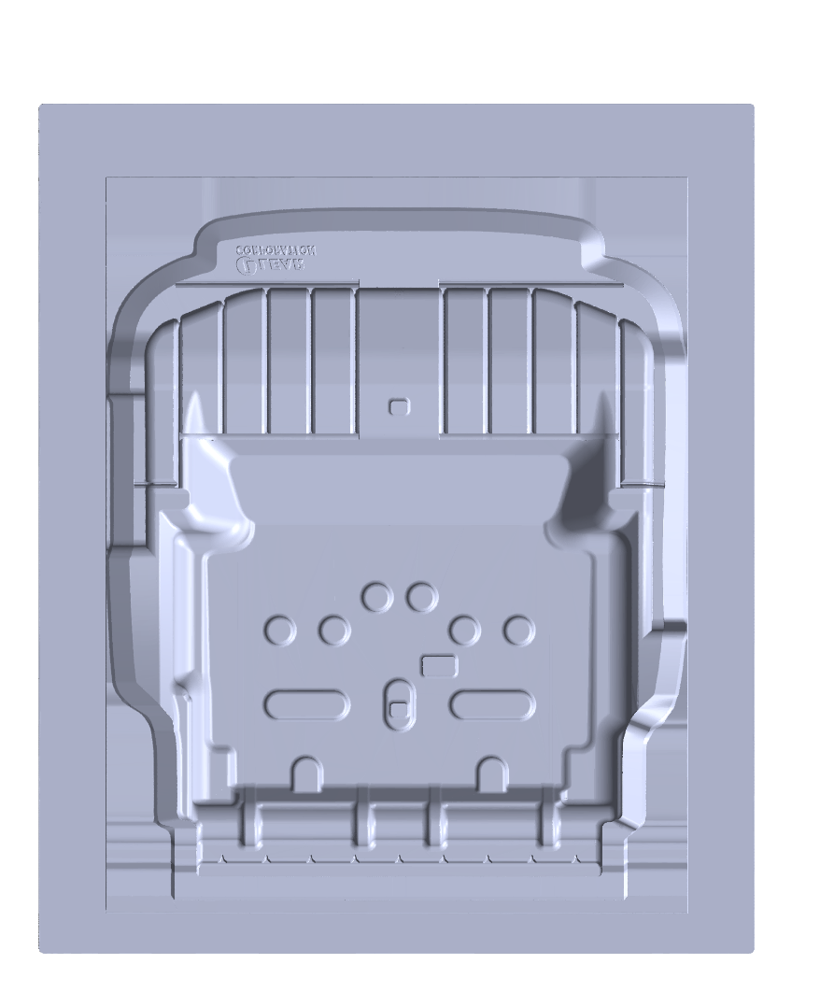
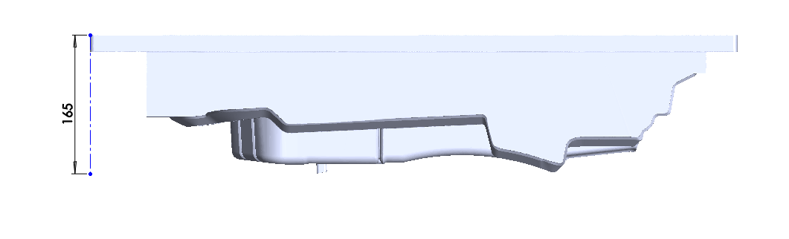
Size & dimensions
Part name: Cushion Foam Core

Slide 6
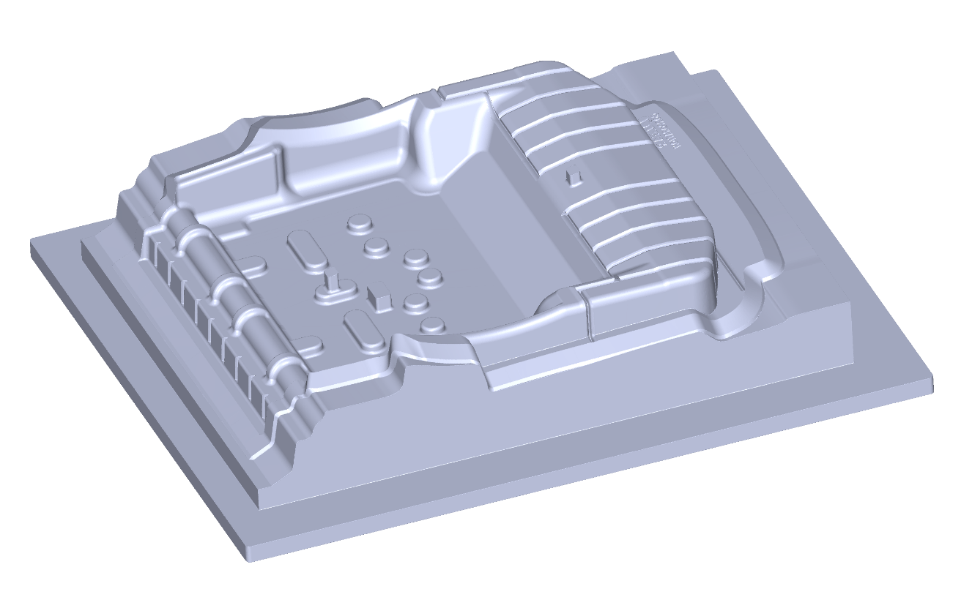
Details
Part: | Layer Thickness: | Casting cure material | Printing shell Material (Washable) | Total weight (Out of the printer) | Print time | Total weight (after shell removal)
Cushion Foam Core | 1 mm | 25 Kg | 8.6 Kg | 33.6 Kg | 26:50 hours | 25 Kg

Slide 7
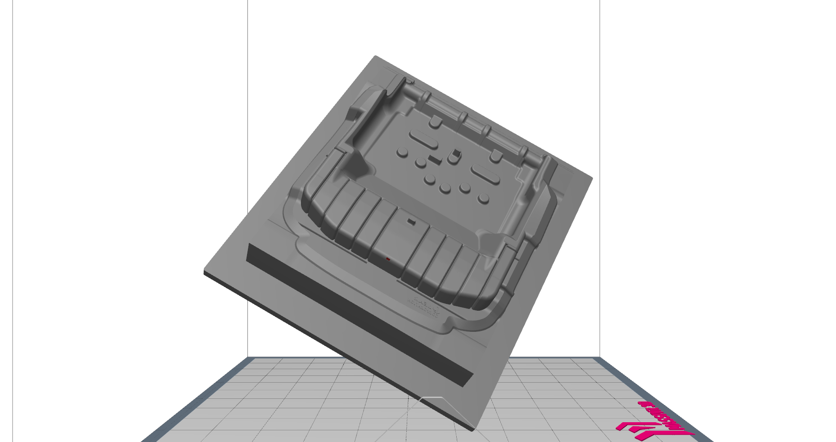
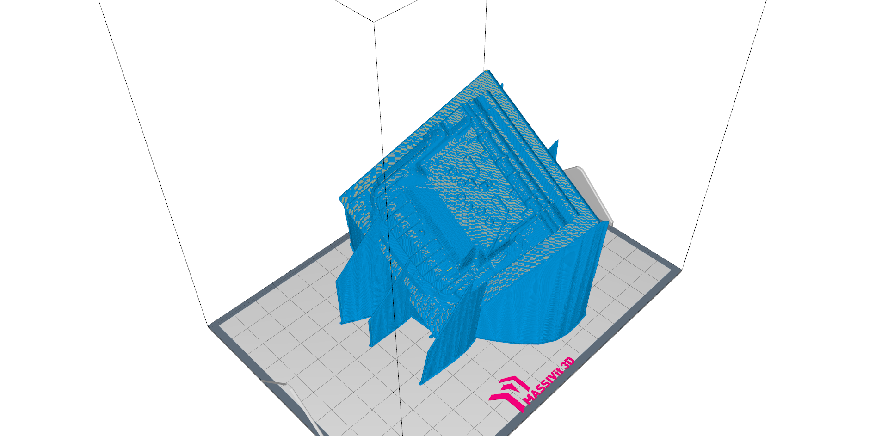
Printing orientation
Printing orientation:
STL file
Tool path

Slide 8


Total
Part: | Layer Thickness: | Casting cure material | Printing shell Material (Washable) | Total weight (Out of the printer) | Print time | Total weight (after shell removal)
Cushion Foam Cavity | 1 mm | 26 Kg | 10 Kg | 36 Kg | 29:10 hours | 26 Kg
Cushion Foam Core | 1 mm | 25 Kg | 8.6 Kg | 33.6 Kg | 26:50 hours | 25 Kg
 |  | 51 Kg | 18.6 Kg | 69.6 Kg | 56:00 hours | 51 Kg

Slide 9
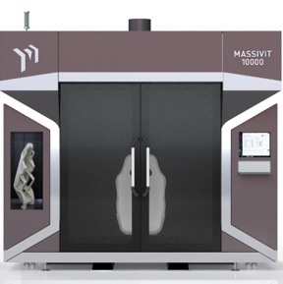
Thank You

